Slide 1
Global AI Readiness and Technological Leadership Across Countries
Done By:
Chennakeshava Akhil Pillalamarri
Student ID: 3043182
MSDS-670: Data Visualization
Regis University

Slide 2
Project Overview
Examines AI readiness across 62 countries
Uses indicators such as talent, infrastructure, research, and commercial activity
Built using Python, Matplotlib, Seaborn, Plotly, and NetworkX
Goal: understand which factors drive global AI leadership

Slide 3
Dataset Overview
Source: AI Index dataset from Kaggle
62 countries, 13 variables
8 numeric columns and 5 categorical columns
Main indicators: Talent, Infrastructure, Research, Development, Government Strategy, Commercial, Total Score

Slide 4
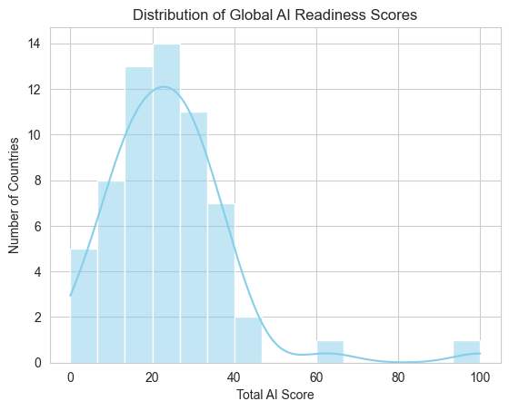
Distribution of Total AI Scores
Most countries fall in the low to mid score range
Distribution is right-skewed
Only a few countries have very high AI readiness
Suggests strong global inequality in AI capability

Slide 5
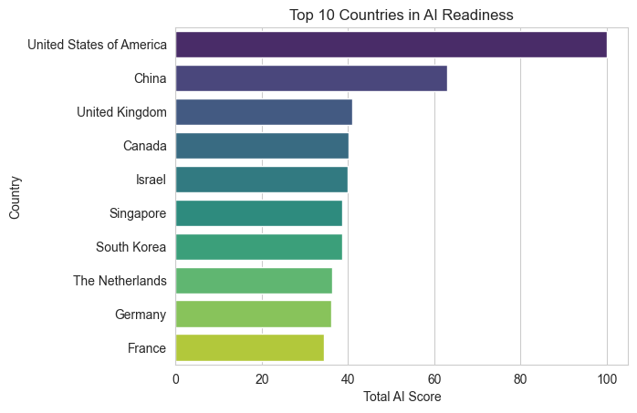
Top 10 Countries in AI Readiness
United States is the clear leader
China ranks second
Top 10 dominated by advanced economies
Large performance gap between the leader and the rest

Slide 6
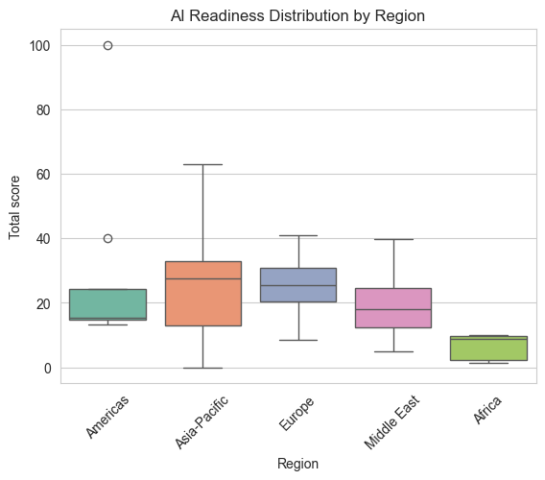
AI Readiness Distribution by Region
Compares AI readiness scores across different world regions
Europe and Asia-Pacific show stronger overall AI readiness levels
The Americas include the highest scoring country globally
Africa has the lowest overall distribution of AI readiness
Regional differences highlight global inequality in AI development

Slide 7
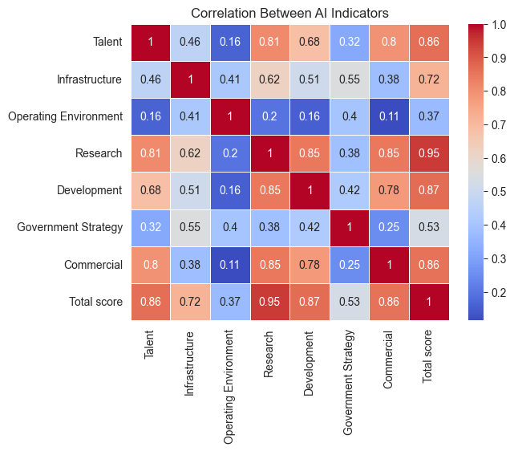
Correlation Between AI Indicators
Shows relationships between major AI indicators
Research has the strongest relationship with total AI readiness
Development and commercial activity also strongly correlate with AI score
Talent contributes significantly to overall AI capability
Indicates that AI readiness depends on multiple interconnected factors

Slide 8
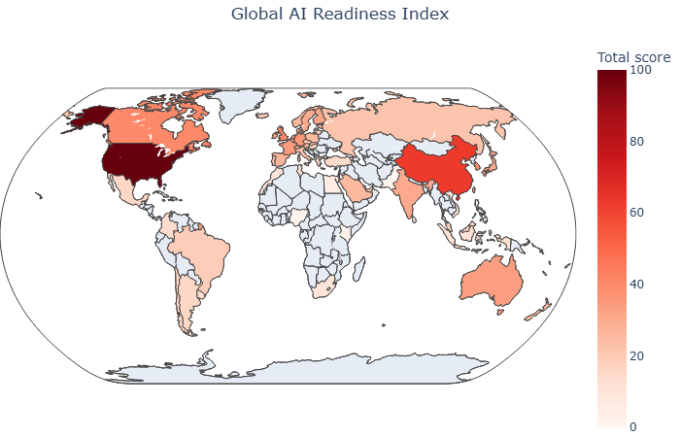
Global AI Readiness Map
Choropleth map visualizes AI readiness geographically
High readiness concentrated in North America, Europe, and parts of Asia
Many developing regions show lower readiness scores
Highlights global disparities in AI development and investment
Geographic visualization helps identify global technology leaders

Slide 9
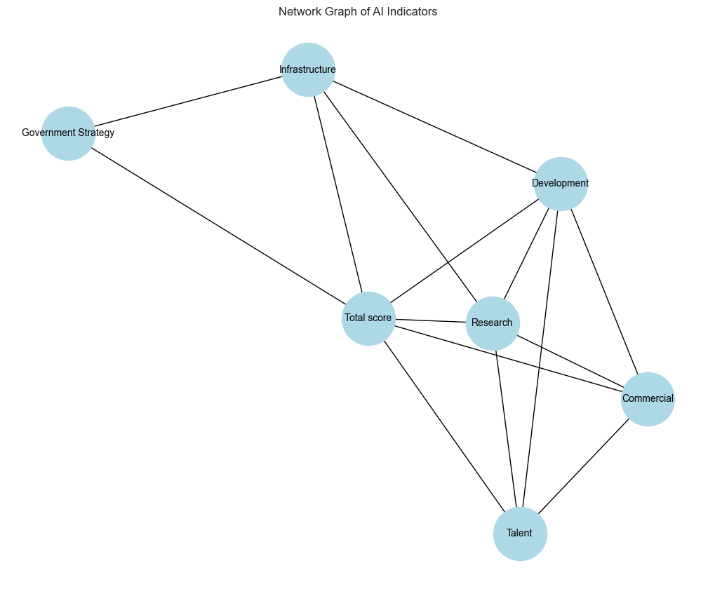
Network Graph of AI Indicators
Visualizes relationships between key AI indicators
Strong correlations create connections between variables
Total AI score acts as the central node in the network
Research, development, talent, and commercial activity form the strongest links
Demonstrates that AI readiness emerges from an interconnected ecosystem

Slide 10
Key Insights
Global AI readiness is concentrated among a small group of countries
The United States remains the dominant AI leader
Europe and Asia-Pacific regions contain several strong AI economies
Research capability strongly influences overall AI readiness
AI success depends on talent, infrastructure, development, and commercial ecosystems

Slide 11
Conclusion
AI readiness varies significantly across countries and regions
Economic strength and research infrastructure play a major role
Global AI leadership is dominated by a few advanced economies
Countries aiming to compete in AI must invest in talent, research, and technology infrastructure

Slide 12
THANK YOU

